Slide 1
Electric Vehicles in Washington
© Templateswise.com

Slide 2
Topics of Analysis:
How is the distribution of electric vehicles (EVs) across different counties and cities?
Which electric vehicle types (BEV or PHEV) are most popular?
What are the most popular makes and models of EVs?
What is the distribution of EVs through the years?
What is the distribution of electric range of vehicles preferred?
What is the relationship between the base MSRP of EVs and their popularity?
What is the market share between EV models?

Slide 3
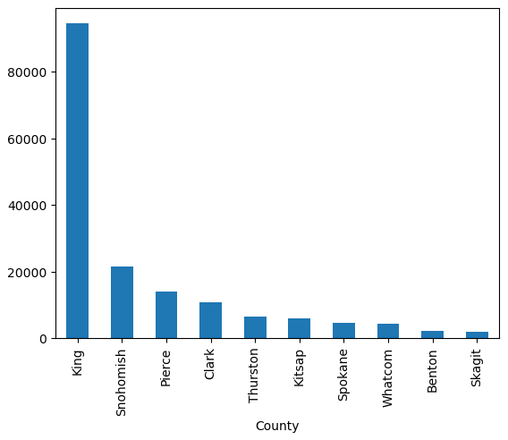
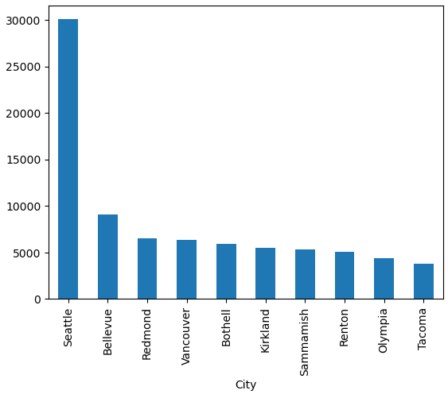
How is the distribution of electric vehicles (EVs) across different counties and cities?
As you can see in the graphs, there is a clear trend in the distribution of electric vehicles (EVs) across Washington State, with a notable concentration in larger cities and urban centers.
This insight underscores the importance of targeted infrastructure development and awareness campaigns to further promote EV adoption in diverse geographic areas.

Slide 4
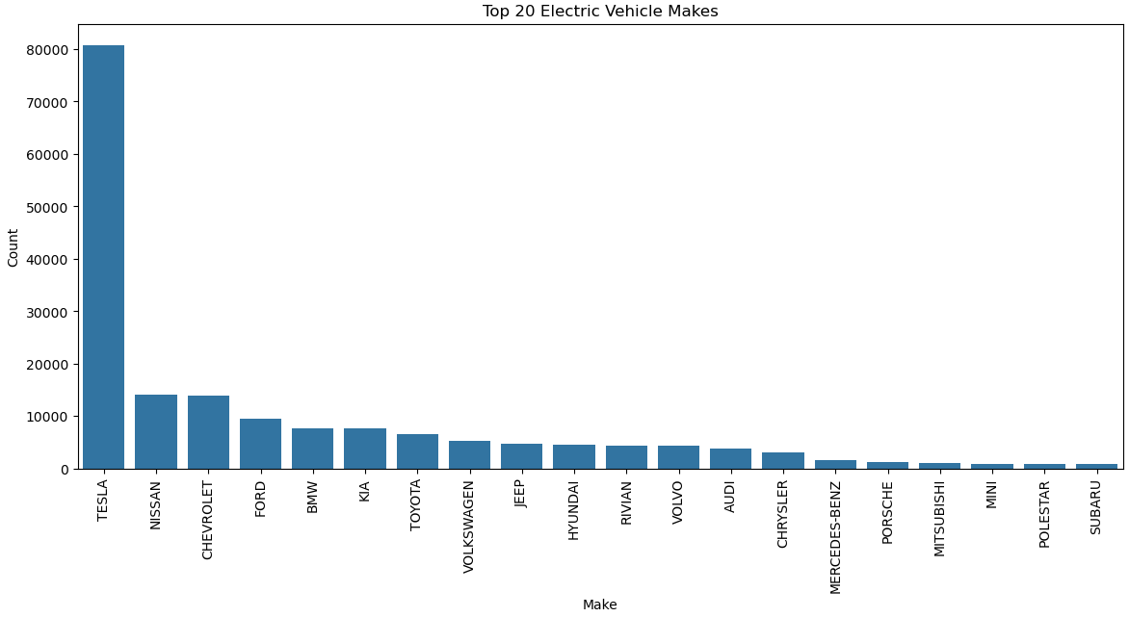
What are the most popular makes and models of EVs?

Slide 5
What are the most popular makes and models of EVs?
Here we see that Tesla is the leading manufacturer in electric vehicles within Washington State, with an impressive 80k registered cars.
Following Tesla, Nissan and Chevrolet hold the next positions with approximately 15k registrations each, showcasing a clear dominance of Tesla in the market.

Slide 6
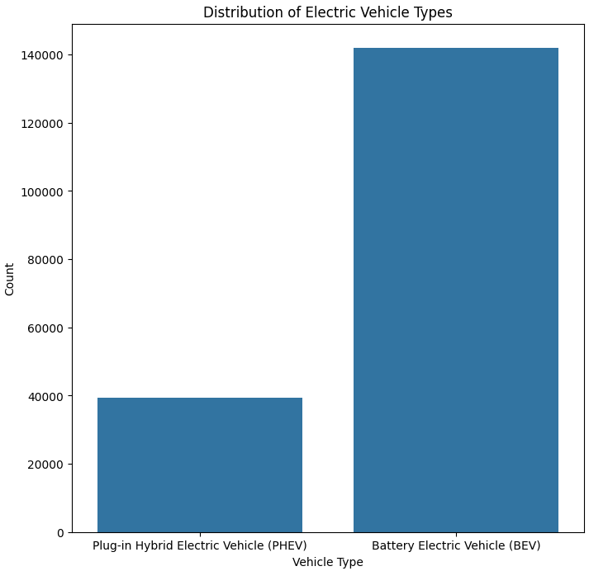
Which electric vehicle types (BEV or PHEV) are most popular?
Among electric vehicle types, Battery Electric Vehicles (BEVs) significantly outpace Plug-in Hybrid Electric Vehicles (PHEVs) in popularity, with approximately 140,000 registrations in Washington State compared to nearly 40,000 PHEVs. This data reflects a clear preference for BEVs over PHEVs in the region.

Slide 7
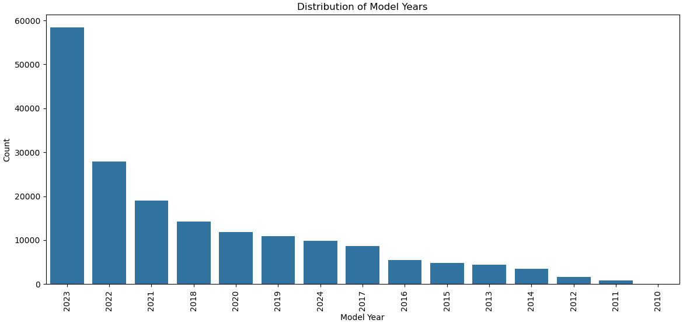
What is the distribution of EVs through the years?

Slide 8
What is the distribution of EVs through the years?
The distribution of EVs through the years shows a remarkable trend of exponential growth in registrations YoY. This signifies a significant and ongoing shift towards electric vehicle adoption, reflecting increasing interest and investment in sustainable transportation options.

Slide 9
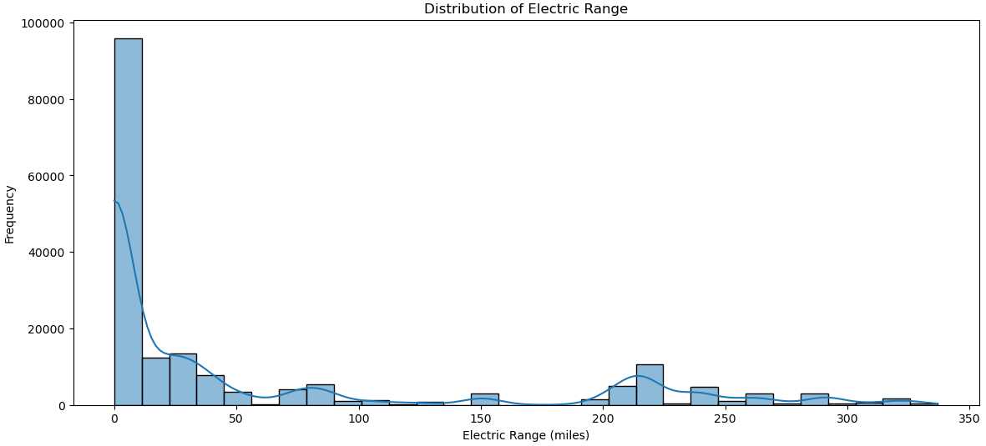
What is the distribution of electric range of vehicles preferred?

Slide 10
What is the distribution of electric range of vehicles preferred?
The analysis reveals a prevalent preference for electric vehicles with a modest range of around 20 miles. This suggests a notable segment of the market prioritizing shorter-range EVs, possibly for urban commuting or specific usage scenarios.

Slide 11
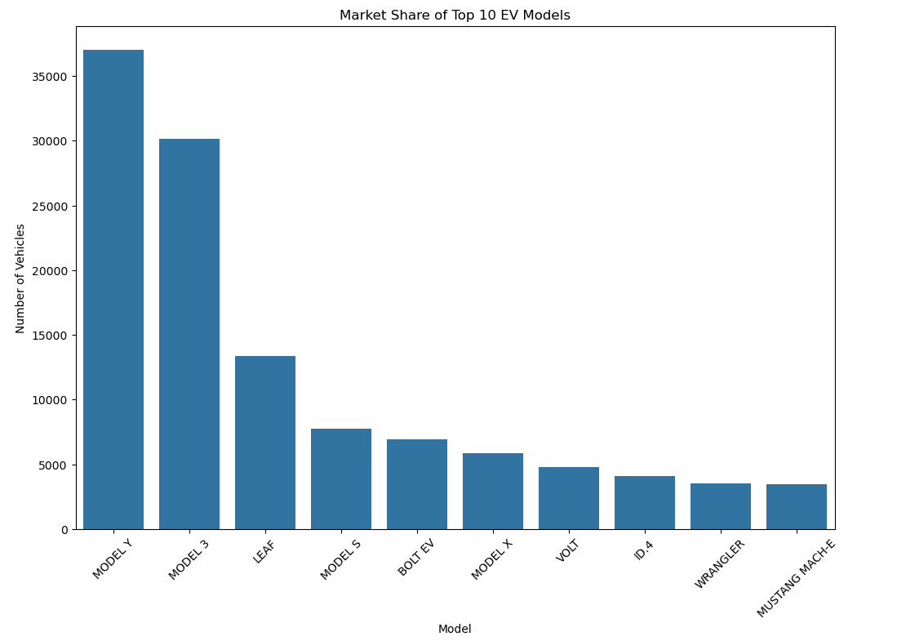
What is the market share between EV models?

Slide 12
Thank You !
© Templateswise.com

